Slide 1
toYou
A project by
Caitlin Mulcahy
Rhys Rushton
Scott Daniels

Slide 2
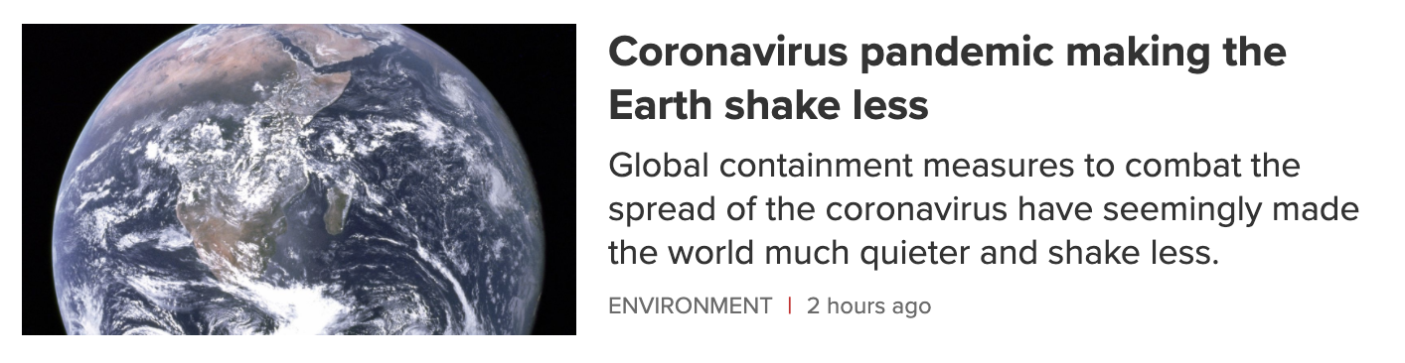
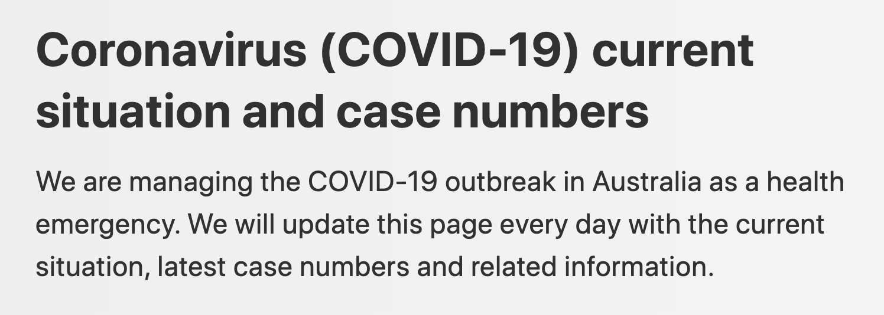


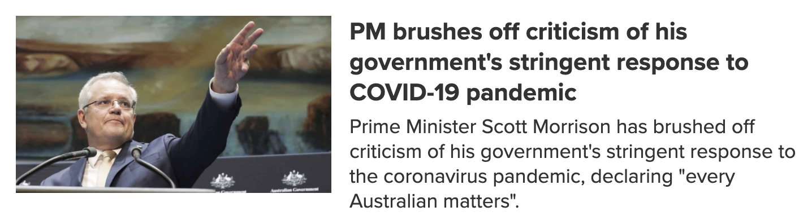

Slide 3
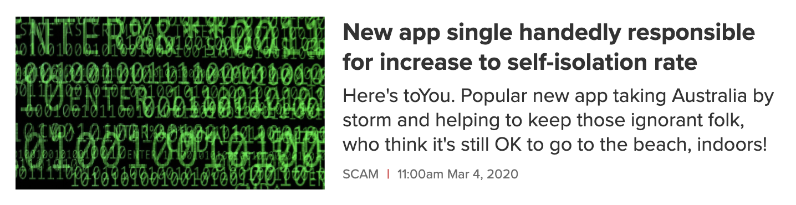

Slide 4
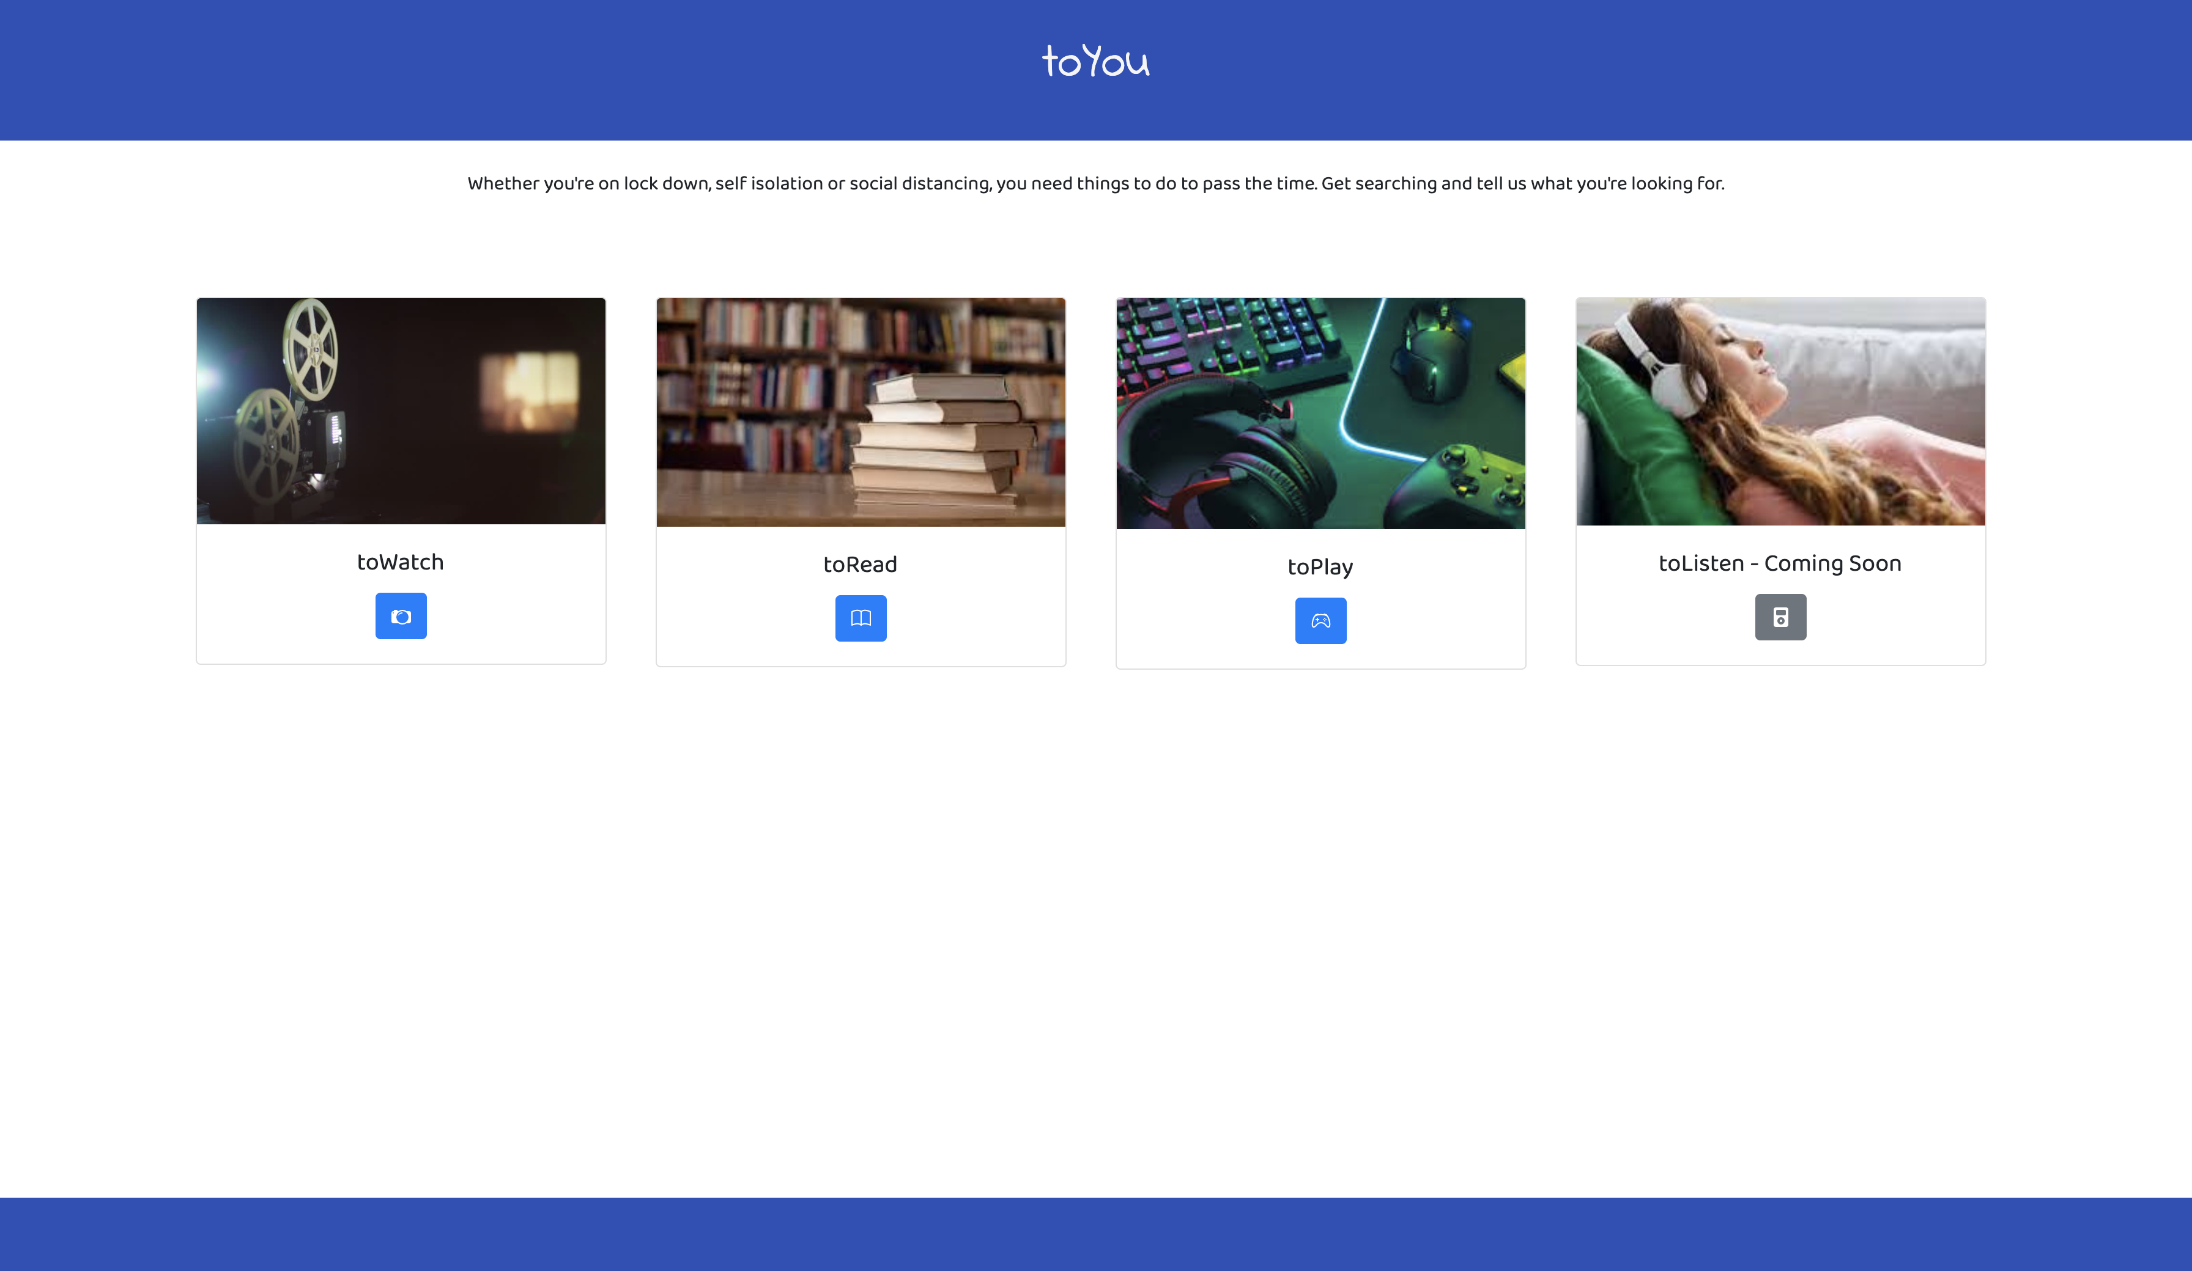

Slide 5
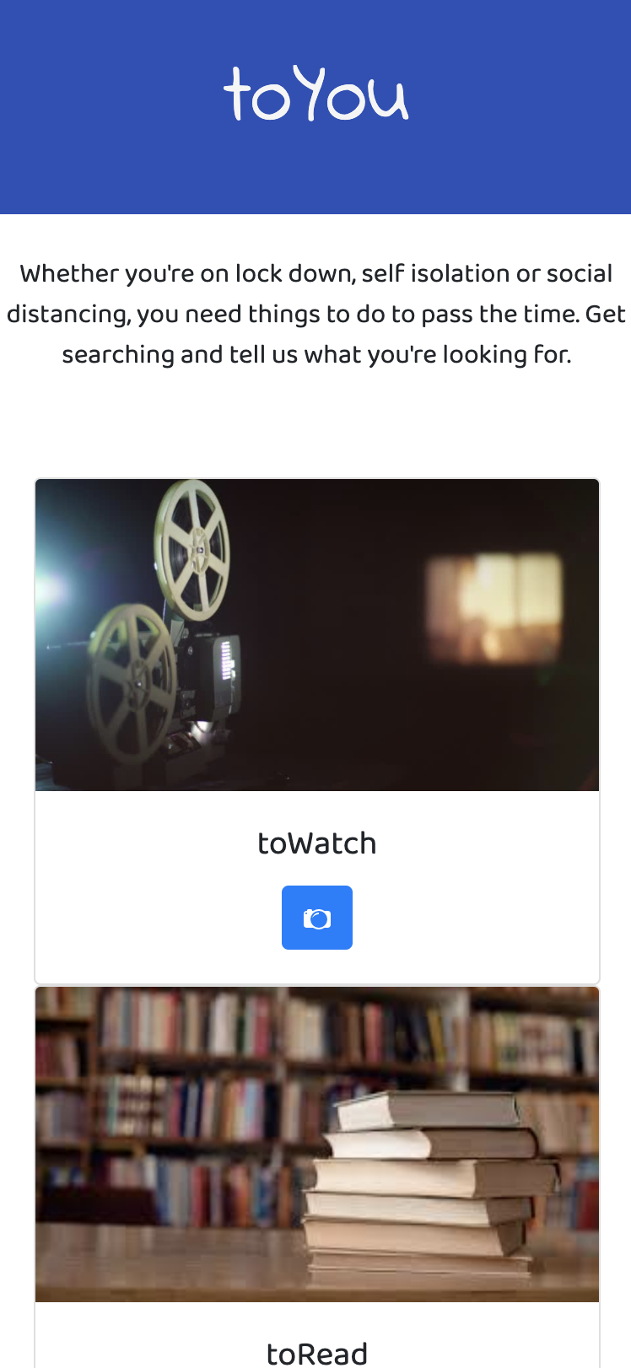
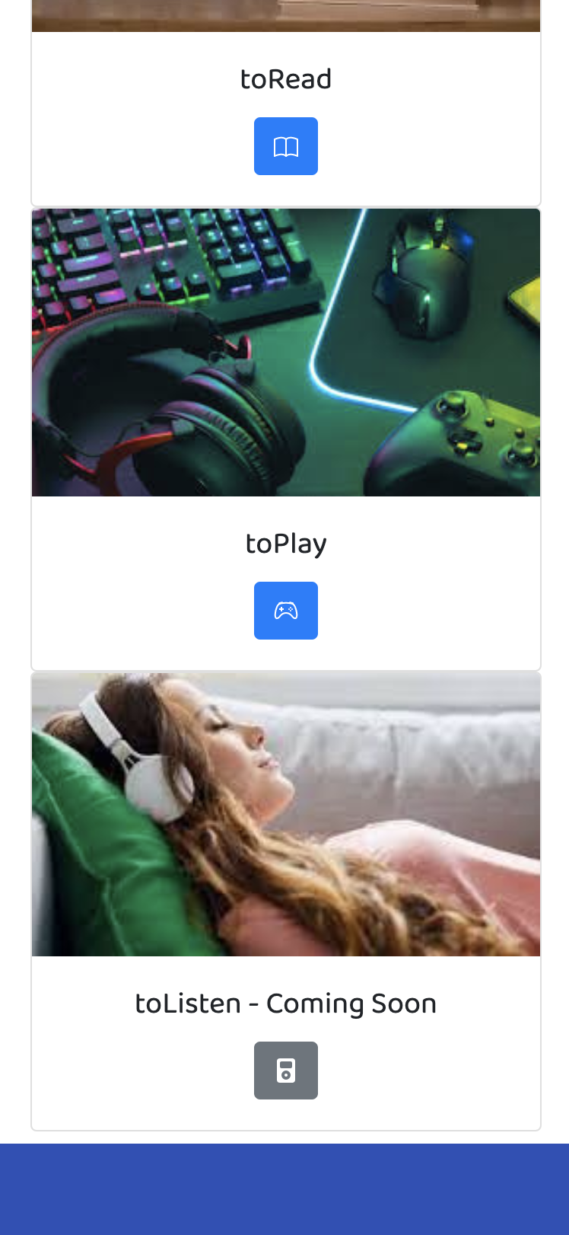
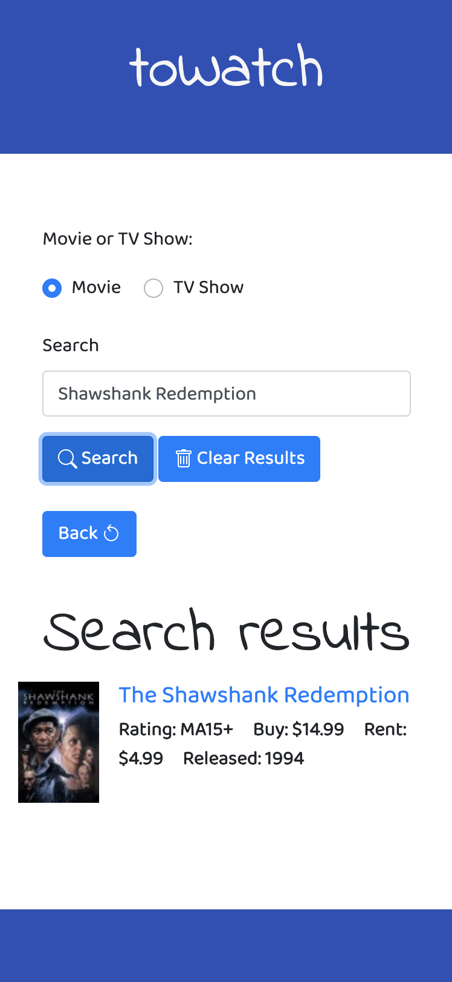

Slide 6
Concept
Technologies
Roles
iTunes API utilised for toYou’s toWatch and toRead pages
Giant Bomb API used for toPlay page
jQuery
Bootstrap
Normalize.css
Caitlin:
App UI & design
HTML & CSS lead
toRead page
Rhys:
Gaming guru for the toPlay page
Giant Bomb API
CSS libraries research
Scott:
iTunes API analyst
toWatch page

Slide 7
The Journey
Challenges
Successes
Analysing API response data
Adapting to restrictions of API query URL
Spell checking and proof reading!
Getting the CORS error
Rendering API results in HTML
Successfully incorporating logic that differentiates media type
Inter-team collaboration to resolve CORS error
Getting it all to work in the end
Our awesome team and effortless teamwork

Slide 8
Future development
Release the toListen feature
Store search history
Improve search features
More APIs! I.e.:
(toRead) Audible…
(toPlay) Steam…
(toWatch) Netflix, Hulu, Disney+…
Integrate toWatch / toPlay / toRead functionality within the app

Slide 9
Links
Repository
Site
https://github.com/Solmarnov/project-zero
https://solmarnov.github.io/project-zero/

Slide 10
Thanks toYou!

